Slide 1
BATTLEBOT
Team 3
Capstone 1 Preliminary Design Review

Slide 2
Who are We?
Group members
Ivan Albert
Nishagar Raventhiran
Cole Trugman
Advisor
James Black
Course
Capstone 1, EMEC 489

Slide 3
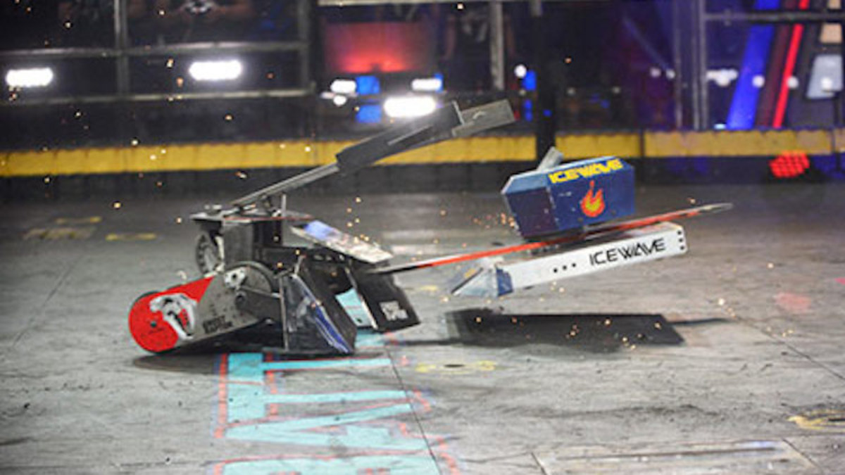
The Competition
Design robot to battle two other opposing robots
Attempt to disable opponents
Ready for any weather
Avoid obstacles in the arena

Slide 4
Level 1 Requirements
Less than 25 lbs
Fit in 18 in cube
Adheres to weapon limitations
Costs less than $1000
Able to run for 3 minutes on one charge
Not a pre assembled robot or toy
Must include a master power disconnect switch

Slide 5
Background
Lessons from televised battlebot competitions
Electrical Controls
Structural Materials
Mobility

Slide 6
Design Specifications
Design specifications were categorized as follows:
Offensive/defensive Specifications
Functional Specifications
Physical Specifications

Slide 7
Offensive/defensive Specifications
Minimum force given by the robot is 20 lb.
Robot must withstand a minimum pushing force of 20 lb as well as 25 lb gravitational force .
Minimum speed of the robot should be 1 ft/s.

Slide 8
Functional Specifications
Have to have enough battery power to run through whole competition
The turning radius of the robot has to be at most 3 ft
Control system must interface with driving motors, and the remote control
Range must be reliable up to 33.5 ft

Slide 9
Physical Specifications
Maximum allowable weight is 25 lb
Must be able to stow into an 18” cube
Radius edges must be greater than ⅛”
Keep the cost between $500 and $1000

Slide 10
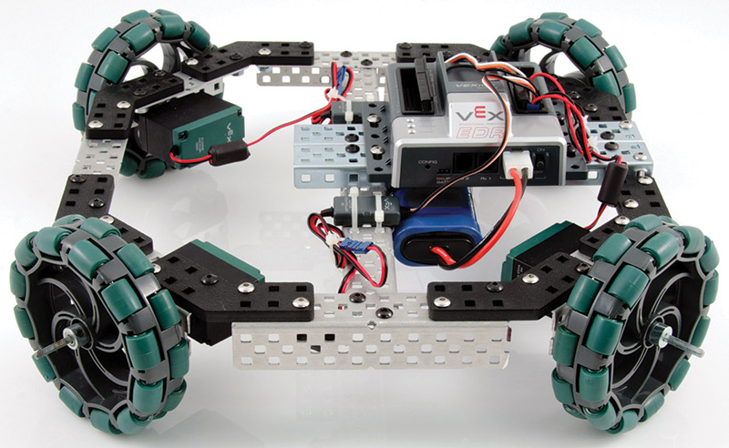
Design Evaluation: Drive System
Drive System | Total Points
Dead Axle: | X
Wheels | 6
Tank Treads | 2
Live Axle | 2
Omni Wheels | 0

Slide 11
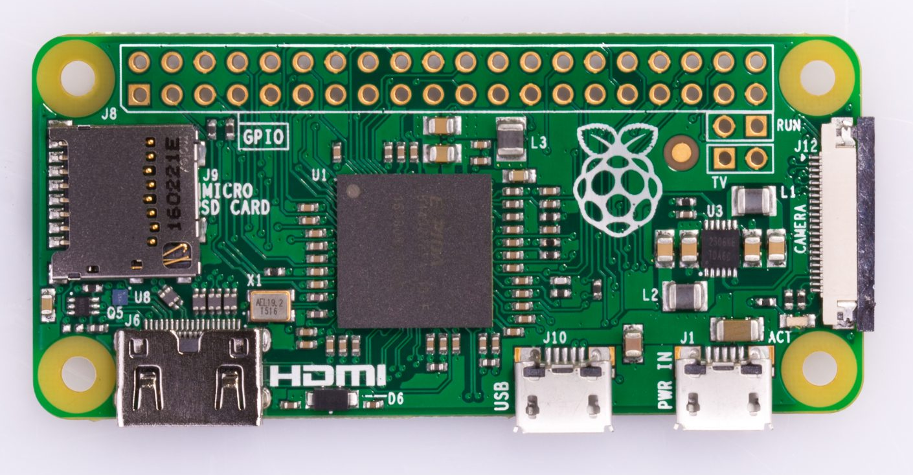
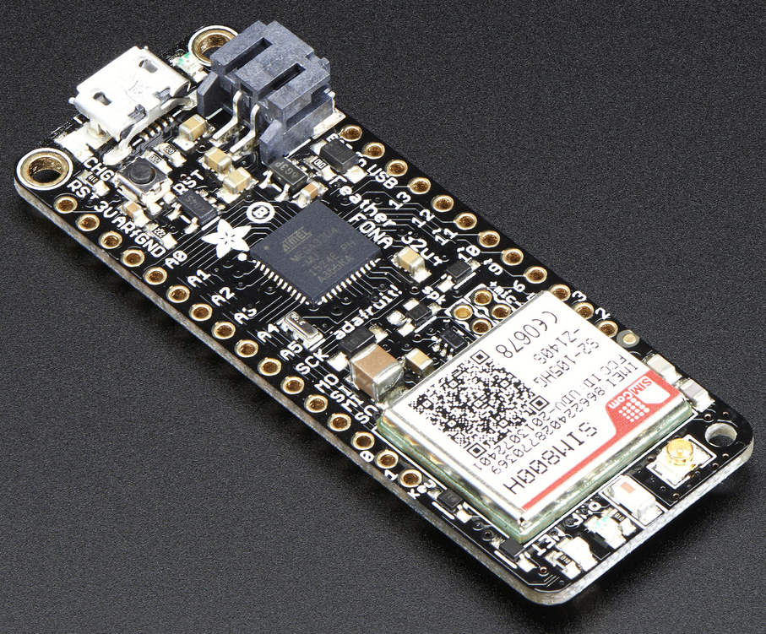
Design Evaluation: Electrical Control System
Electronic Control System | Total Points
Microcontroller: | X
Bluetooth | 5
Radio | 4
Wi-Fi | 3
Off the Shelf RC Parts | 3

Slide 12
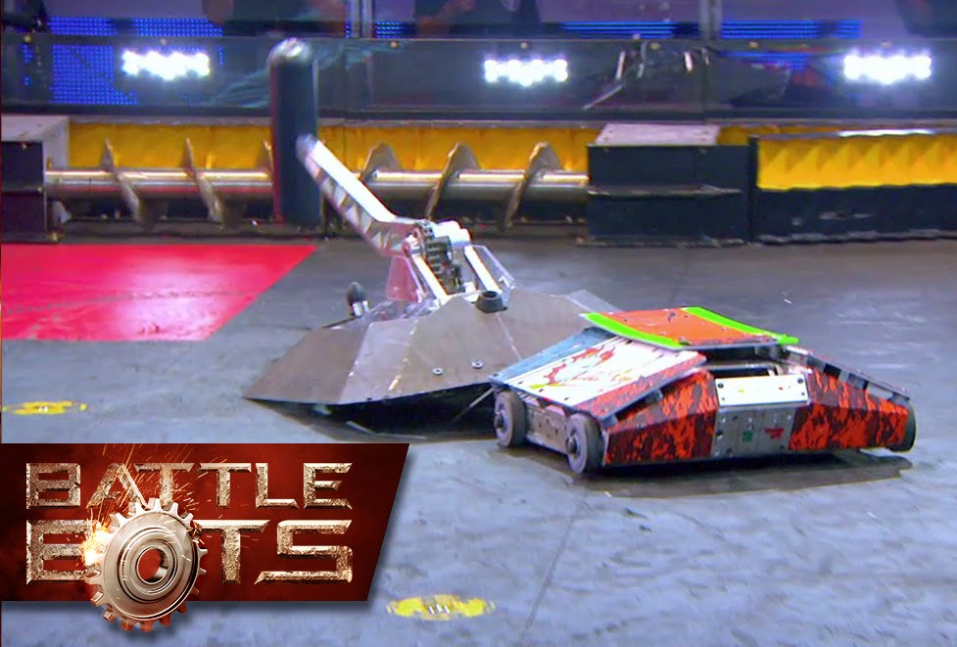
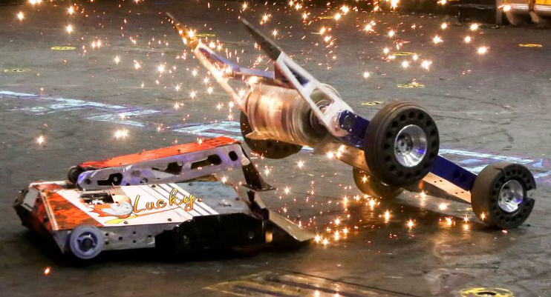
Design Evaluation: Weapon System
Weapon System | Total Points
Roller | 5
Hammer | 4
“Hermit Crab” | 2
Hydraulic Wedge | 0
Spatula | 0

Slide 13

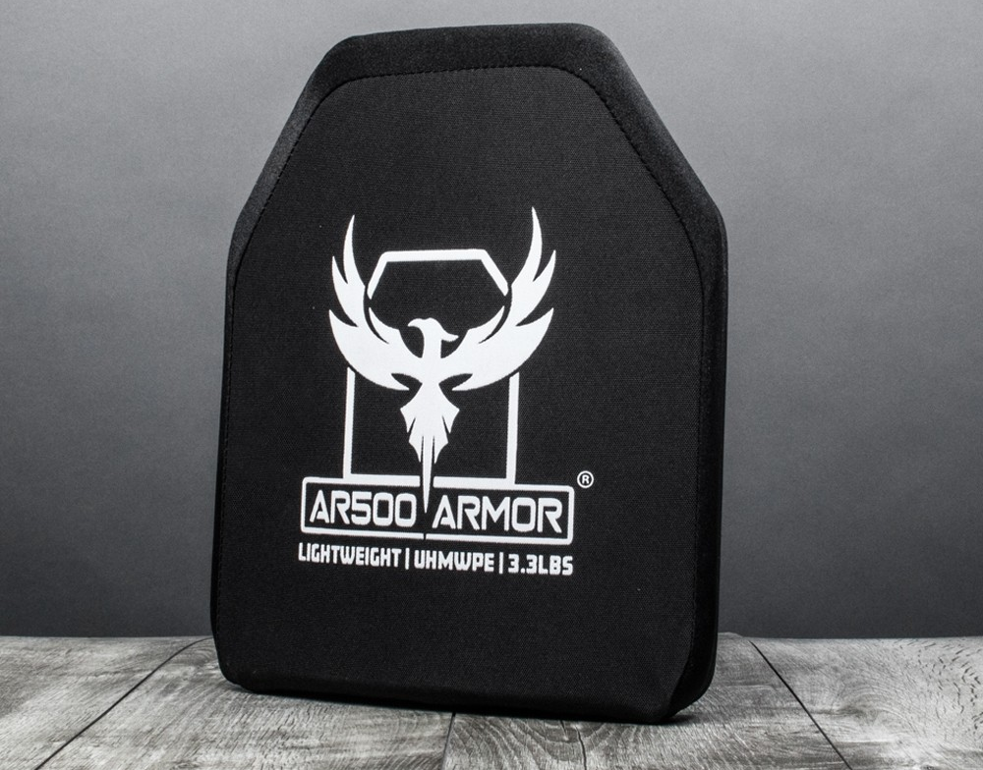
Design Evaluation: Armor
Armor | Total Points
Aluminum | 3
1018 Steel | 2
UHMWPE | 1
AR400 Steel | 0

Slide 14
Design Alternatives
Design | Drive System | Electrical System | Weapon | Armor | Total Points
Design 1 | Dead Axle: Wheels | Micro: Bluetooth | Roller | Aluminum | 19
 | 6 | 5 | 5 | 3
Design 2 | Omni Wheels | Micro: Radio | Hammer | UHMWPE | 9
 | 0 | 4 | 4 | 1
Design 3 | Dead Axle: Wheels | Micro: Bluetooth | Hydraulic Wedge | 1018 Steel | 13
 | 6 | 5 | 0 | 2

Slide 15
Chosen Design
Roller as main weapon system
Wedge in rear
Dead axle drive
Aluminum with layer of Ar400 (where applicable)
Reprogrammable microcontroller

Slide 16
Timeline
November 26: Have CDR presentation ready
November 30: Finish drawings/models/Manufacturing plan
December 3: Complete written report
December 10: Buy materials and components
December 14: Start manufacturing
January: Start programming microcontroller.
March: Integrate subsystems
April: Testing robot
May: Competition day

